Slide 1
Bionics Solution for Myasthenia Gravis
Agathiya, Atharva, CJ, Jake

Slide 2
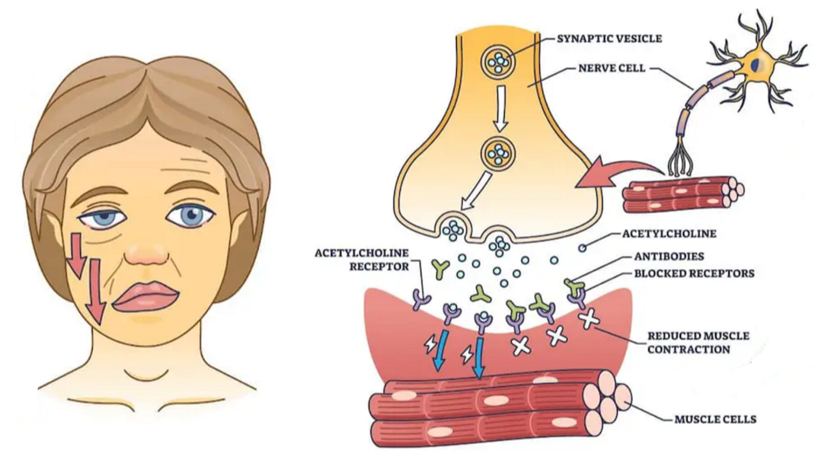
Background
Myasthenia Gravis (MG)
Inhibits neuromuscular junction and prevents neural impulses from reaching the muscle
Blocks acetylcholine receptors
Notes:
What pathology have you chosen to address?
Why is this important?
Who does it affect?
Use this section to hook your audience, and make us care about what you have to say during the rest of the talk.

Slide 3
Background
Most common in:
Women under 40
Men over 60
Loss of muscular function, limited facial expressions, fatigue, difficulty walking
Notes:
What pathology have you chosen to address?
Why is this important?
Who does it affect?
Use this section to hook your audience, and make us care about what you have to say during the rest of the talk.

Slide 4
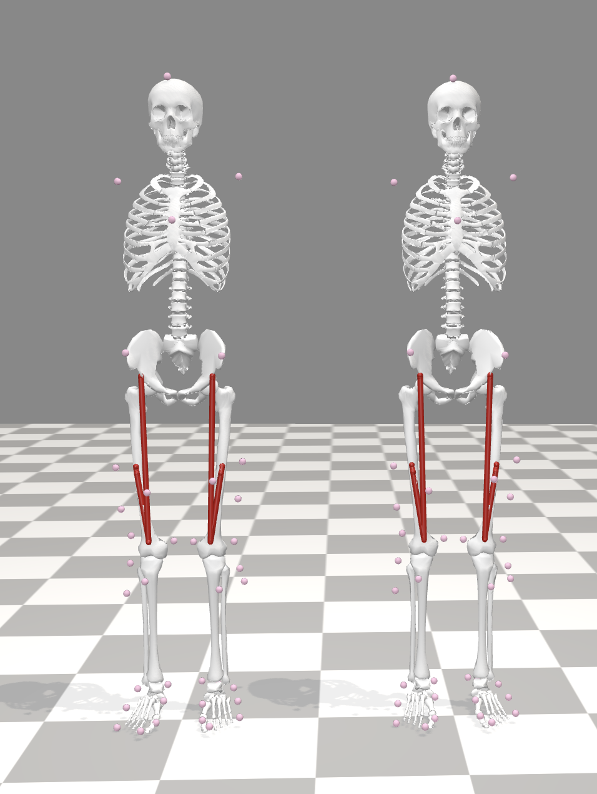
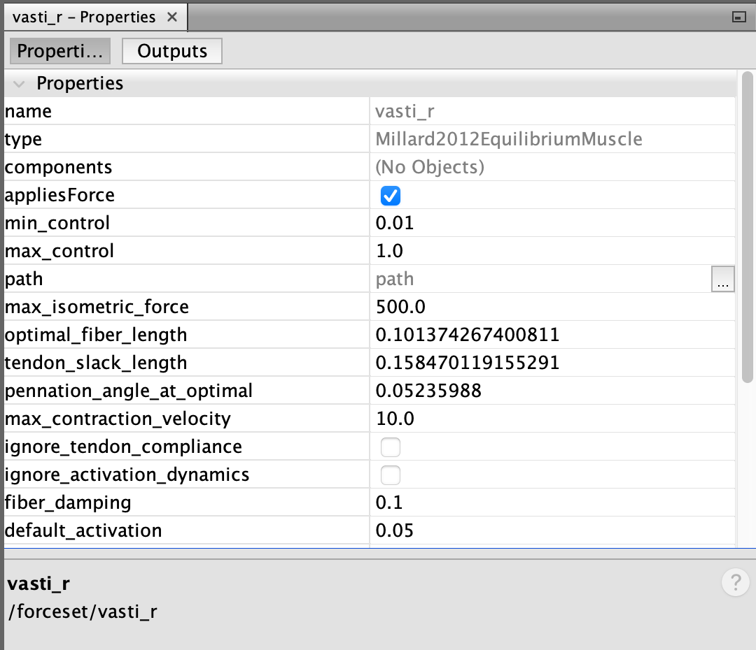
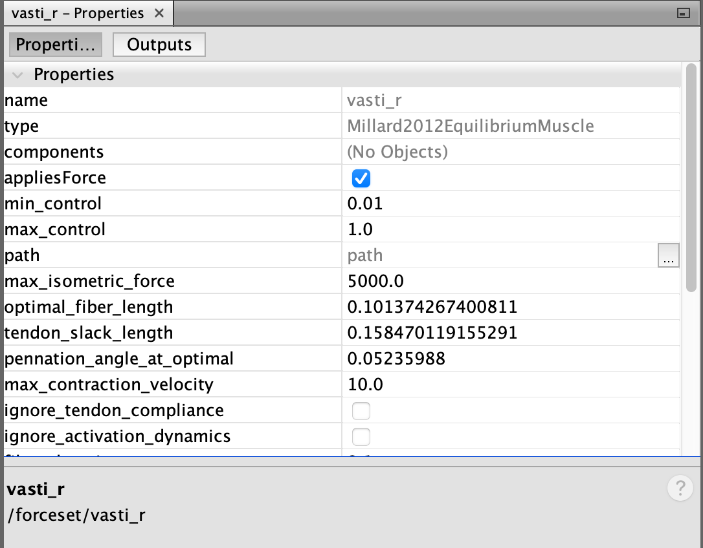
Biomechanical Modeling | Pathology
Used the ‘gait10dof18musc’ model
Created a healthy and unhealthy (MG) copy
Reduced max isometric force (5000N → 500N)
Unhealthy
Healthy
Rectus femoris
Vasti
Weakened
Weakened vasti muscle properties
Healthy vasti muscle properties
Healthy and unhealthy gait10dof18musc model
Notes:
How did you model your pathology, and why did you model it that way?
Used 2 models of gait10dof18musc: This model focuses on the lower extremity, and groups the vasti muscle into one (simplifies simulation), have 2 models to compare muscle performance between healthy and unhealthy
Reduced Fmax: this change reflects the muscles weakened force-generating capability (thus simulating the lack of neural signals reaching a muscle)

Slide 5
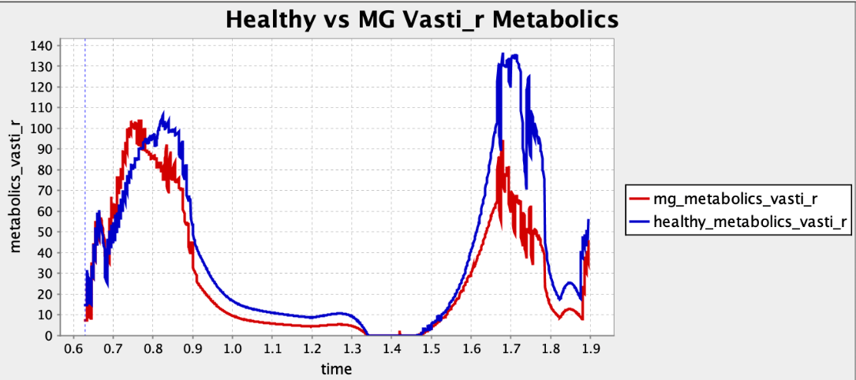
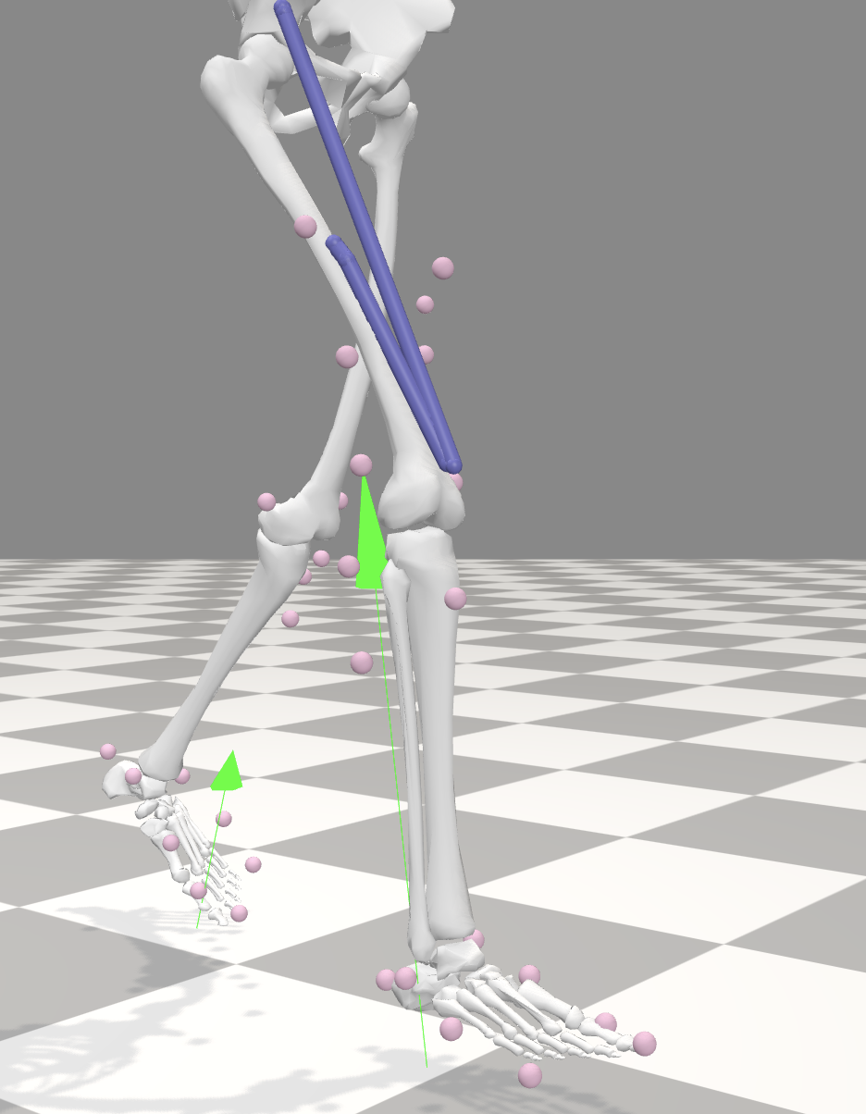
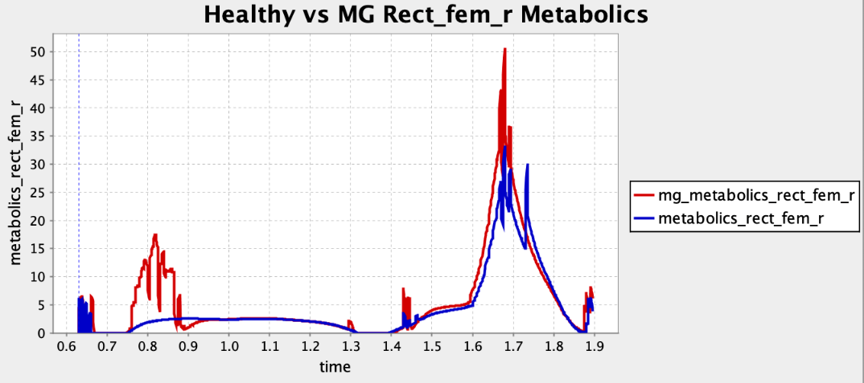
Biomechanical Modeling | Pathology
Healthy vs unhealthy vasti muscle metabolics
Healthy vs unhealthy rectus femoris muscle metabolics
Stance phase with ground reaction force
Notes:
In Figure 4, the weakened vasti muscle metabolic cost peaks during stance phase at around 0.75 seconds, where knee stabilization is crucial to handle ground reaction forces. After this phase, the weakened vasti generate less force, leading to lower metabolic demand compared to the healthy case.
Figure 5 shows the rectus femoris compensating for the vasti’s weakness. In the MG case, it peaks again during the stance phase and at swing phase, with increased activation to stabilize the knee and support forward motion.

Slide 6
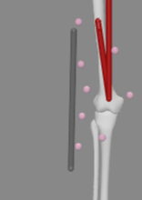
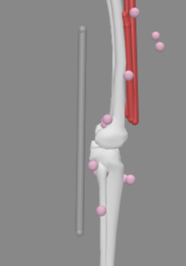
Biomechanical Modeling | Pathology
Modeled a path actuator in 2 configurations
Tested for 4 different max isometric forces in the actuator 7
700N, 1000N, 2000N, 3000N
Optimized the system to reduce the effort required by the rectus femoris muscle
Computed the torque from forces and moment arm
Lateral
Posterior
Notes:
Preliminary analysis showed Vasti muscle utilizes only about 1000N of force during normal gait, so the muscle was weakened to 500N from 5000N to realistically model MG
The isometric force values for actuator were chosen based on the vasti muscle usage in the healthy gait
Modelled a path actuator using custom Python script and then adjusted the placement in OpenSim
Frame fixation- Tibia and Femur
Moment arms were calculated using the compute Moment Arm script and for torques just multiplied forces and moment arms

Slide 7
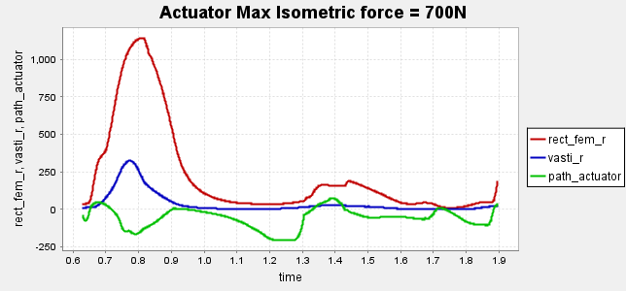
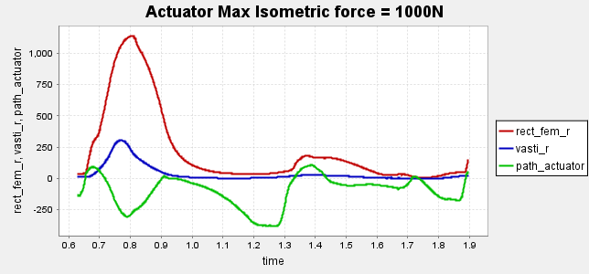
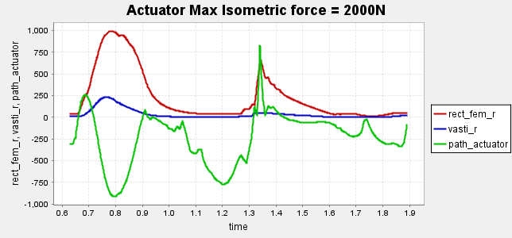
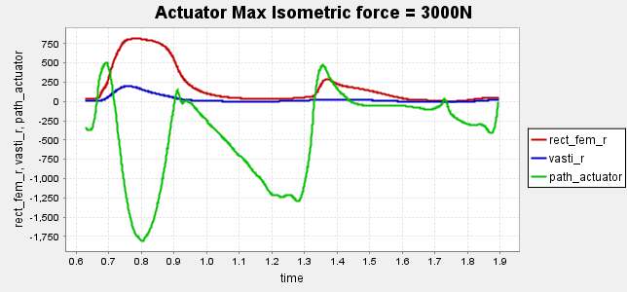
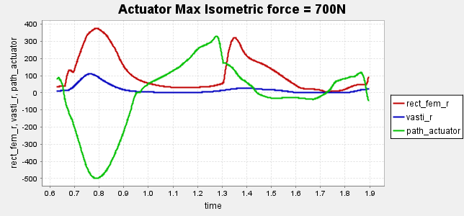
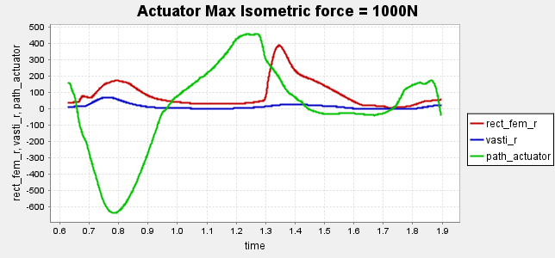
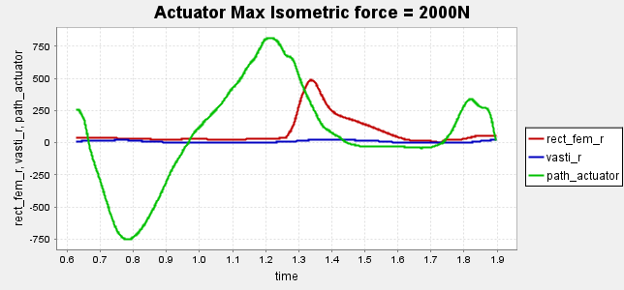
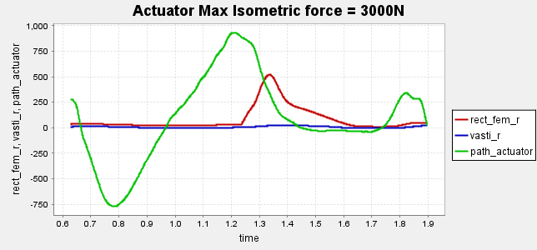
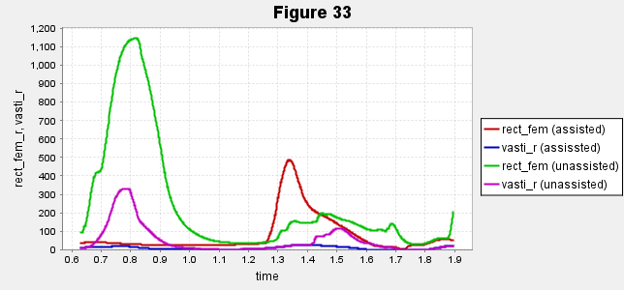
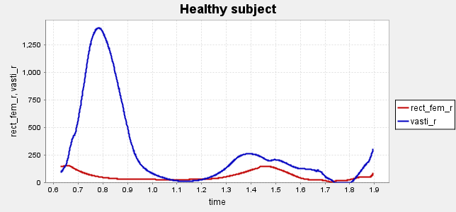
Biomechanical Modeling | Bionic System
Lateral
Posterior
Assisted vs Unassisted
Healthy
Notes:
The plots take into account the assumed bionic system weight of 3 kg with 2.75 kg added to femur and 0.25 kg added to tibia
Rectus femoris is not utilized in normal gait and most of the load is taken by Vasti.
With reduced vasti capacity, the posterior placed actuator mimics the actual muscle usage of rectus femoris
0.8 is footflat where torque changes direction 1.2 is where again the torque changes direction in pushoffs

Slide 8
Biomechanical Modeling | Bionic System
Assisted vs Unassisted
Healthy
Lateral
Posterior
Notes:
The plots take into account the assumed bionic system weight of 3 kg with 2.75 kg added to femur and 0.25 kg added to tibia
Rectus femoris is not utilized in normal gait and most of the load is taken by Vasti.
With reduced vasti capacity, the posterior placed actuator mimics the actual muscle usage of rectus femoris

Slide 9
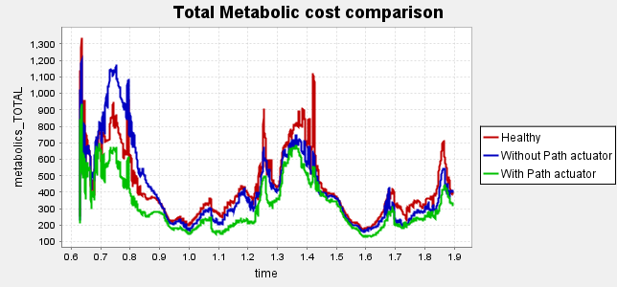
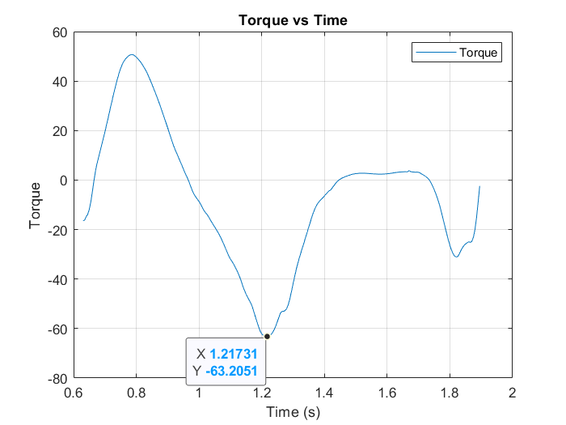
Biomechanical Modeling | Bionic System
The overall metabolic cost of gait with MG with the actuator is low compared to unassisted gait, indicating that the bionic system aided in gait
The forces generated in the rectus femoris and vasti in the model with the actuator is far less than those in the model without the actuator

Slide 10
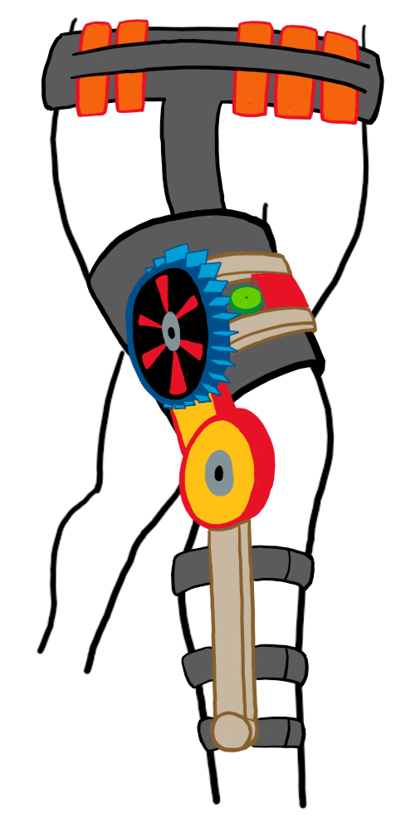
Bionic System Design
High Level
Notes:
Present your system design from a high-level.

Slide 11

Bionic System Design
High Level
Battery Packs
Kevlar Waist Strap
Reduce gait load
Wiring within Kevlar
3 stacks of 4 for 45 min
Electronics
Microcontroller
Motor Driver
Longitudinal Fins
6.7W heat dissipation
EMG Patches
3 patches around the thigh
Motor Encoder
U8 KV100 Motor
Kevlar Suit
Safely operates within $±$48V range
Thermal insulation and durability
Notes:
Present your system design from a high-level.

Slide 12
Bionic System Design
High Level
Torque Sensor
Transmission
Multi-stage geartrain; N = 45
Kevlar Straps
Aluminum Frame
Secures bionic system to leg
Structure and support
Notes:
Present your system design from a high-level.

Slide 13

Kevlar Waist Strap
Battery Packs
Reduce gait load
Wiring within Kevlar
3 stacks of 4 for 45 min
Electronics
Longitudinal Fins
Microcontroller
Motor Driver
6.7W heat dissipation
Motor Encoder
EMG Patches
U8 KV100 Motor
3 patches around the thigh
Safely operates within $±$48V range
Kevlar Suit
Aluminum Frame
Thermal insulation and durability
Structure and support
Torque Sensor
Kevlar Straps
Transmission
Secures bionic system to leg
Multi-stage geartrain; N = 45
Notes:
Present your system design from a high-level.

Slide 14
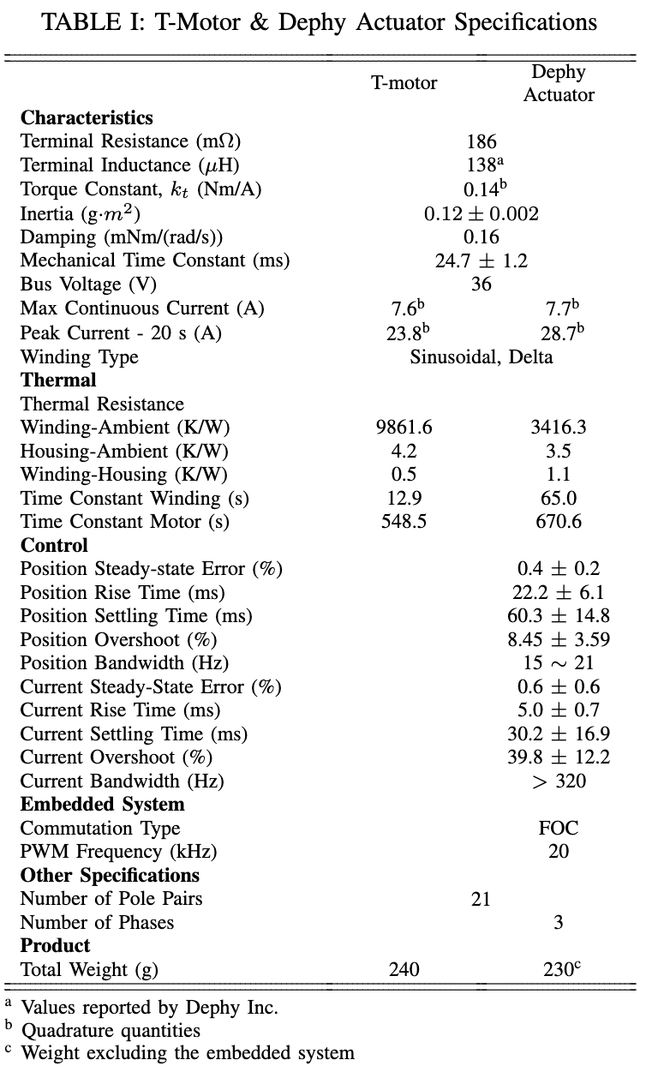
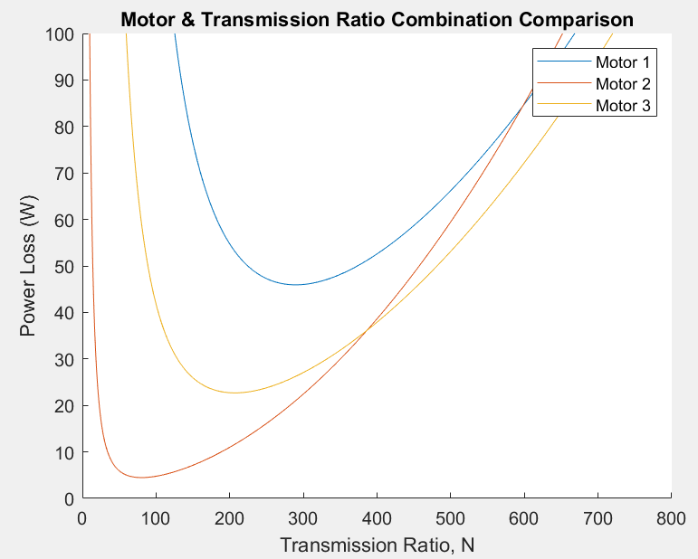
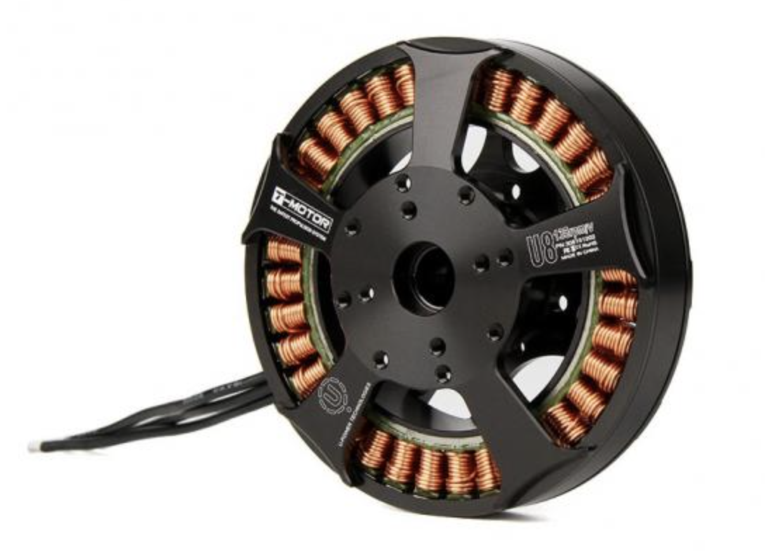
Bionic System Design | Actuator
T-Motor U8 KV100
Multi-stage geartrain
Transmission Ratio: 45
9:1 and 5:1 geartrains
Power Loss = 6.7W
@ N = 45
T-Motor U8 KV100
Notes:
What actuator did you choose, and why?
Played around with a few motors but ended up with the U8 KV100 motor due to its ability to operate efficiently to meet the required torque trajectory. We Started by using a random motor to see what the current and voltage requirements are, then we did an iterative process until we found a motor thats able to operate within reasonable voltage and current requirements to meet the required torque trajectory.
What is the optimal transmission ratio?
Now that we have the motor properties down, we then optimized for power loss by tuning the transmission ratio. While trying to minimize the power loss, we also have to ensure that the transmission ratio allows us to meet the peak torque required which was around 60 Nm. After doing this process, we found that a transmission ratio of 45 gives us the required peak torque, is within reasonable voltage and current requirements and also a relatively low power loss of 6.7W.
How is your transmission designed to achieve that ratio?
To achieve a transmission ratio of 45, we can use 2 sets of gears with 9:1 and 5:1 gear ratios.

Slide 15
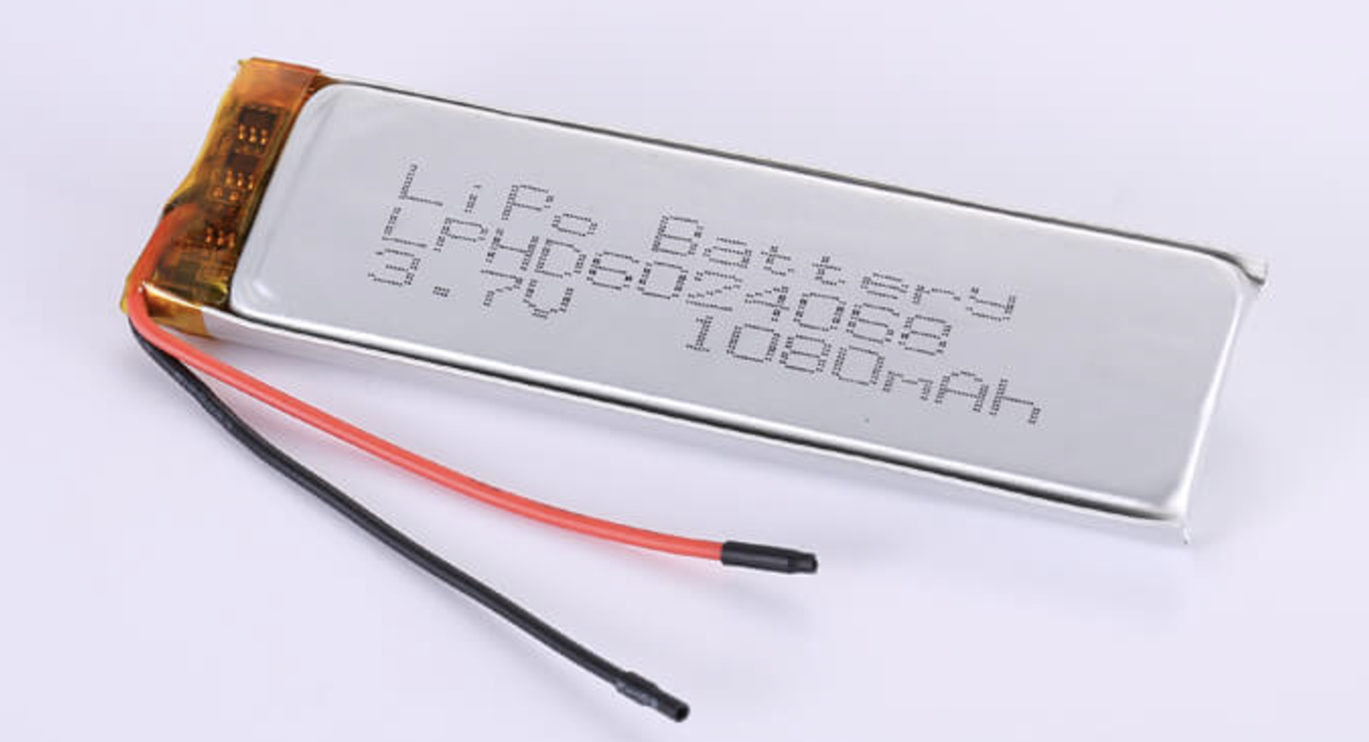
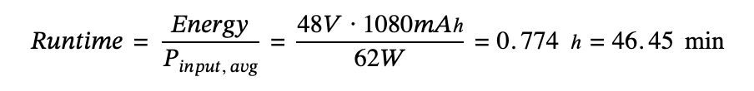
Bionic System Design | Power Supply
Array of 13 High Rate Discharge LiPo batteries
Provides 48.1V and 1080 mAh capacity
15C → can draw up to 16.2 A
Each battery = 25g → total of 325g
Runtime of ~46 mins
Option for swappable batteries and/or larger batteries (e.g. 2160 mAh, 13S2P)
3.7V, 1080 mAh, 15C
Connected in series (13S1P)
High Rate Discharge 3.7V 1080mAh 15C LiPo Battery
Notes:
The power supply of the bionic system is an array of 13…
Can also add more batterues to expan

Slide 16
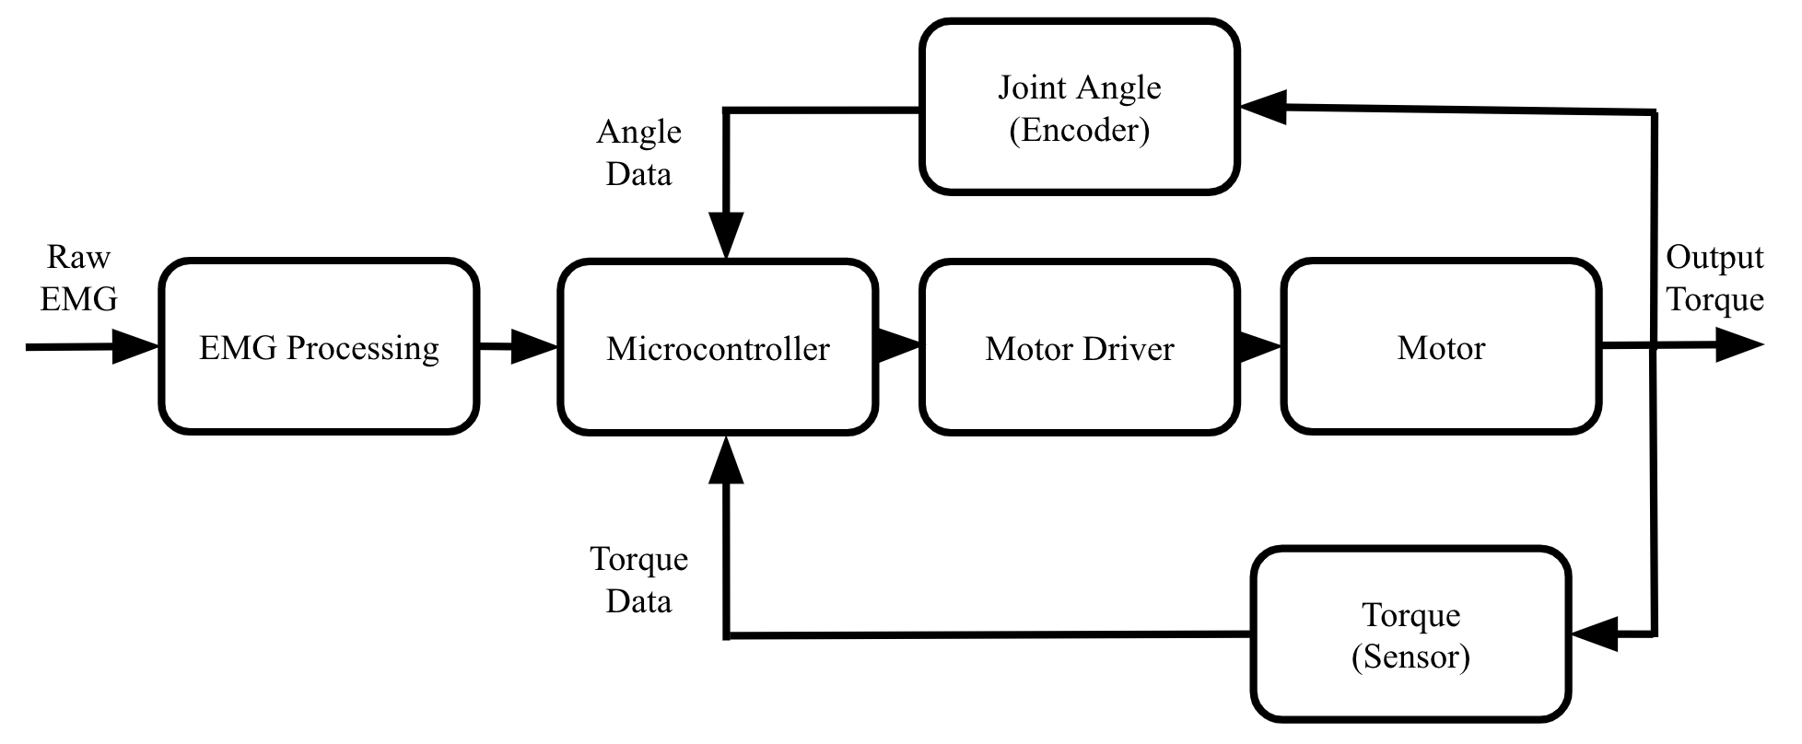
Bionic System Design | Controls
Low Level:
ADCs built into sensors, communicate to MC
Microcontroller uses data and PID control to command motor driver
High Level:
Topical EMG sensor on rectus femoris used to control motor and apply torque
Mid Level:
Joint angle encoder
Output torque sensor
Controls Flowchart
Notes:
For the controls of the system, from a high level a topical EMG sensor on the rectus femoris is used to control the motor and apply to to the knee joint.

Slide 17
Bionic System Design | Controls
Low Level:
ADCs built into sensors, communicate to MC
Microcontroller uses data and PID control to command motor driver
High Level:
Topical EMG sensor on rectus femoris used to control motor and apply torque
Mid Level:
Joint angle encoder
Output torque sensor
Controls Flowchart
Notes:
For the controls of the system, from a high level a topical EMG sensor on the rectus femoris is used to control the motor and apply to to the knee joint.

Slide 18
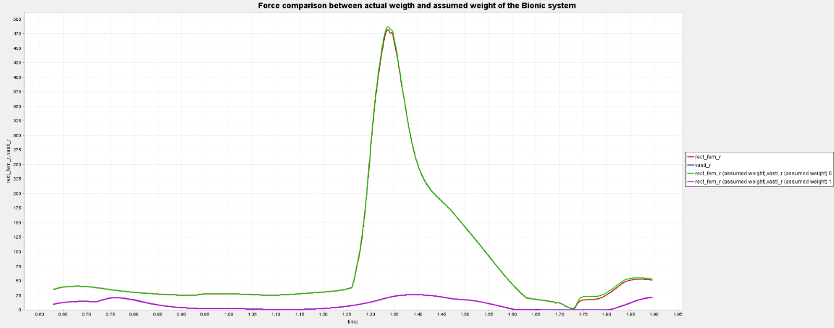
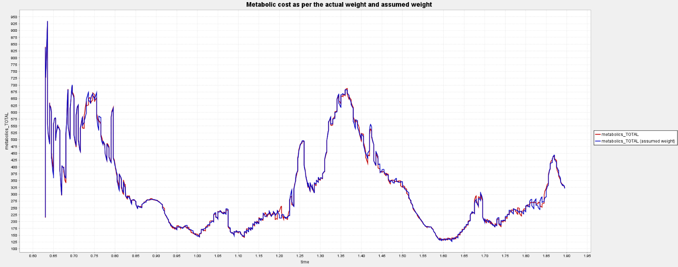
Bionic System Design | Results
The simulation was rerun with the true calculated weight of the bionic: 1.75kg
There was negligible change in the metabolic cost or the forces in vasti and rectus femoris due to the weight change in the bionic system
Notes:
This suggests we can add more weight on the femur for upto 2.75 kg (like batteries) without any significant change in the metabolic cost which could lead to extended system life

Slide 19
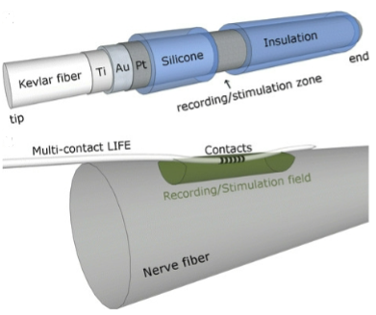
Surgical Innovation
ENG instead of EMG allows for better readings of intended muscle movement
Intrafasicular electrode into the femoral nerve to read the impulses before they get blocked at the NMJ
Costs
Benefits
Risk of infection
Nerve damage
Electrode displacement
Cost
Better readings of impulses
Reduced cognitive effort
More accurate movements
Pronounced movements
Notes:
What surgical techniques do you recommend be applied to improve
your system? What are the potential risks of these techniques? Do the potential benefits
outweigh the costs of invasiveness?

Slide 20
Surgical Innovation
Costs
Benefits
Risk of infection
Nerve damage
Electrode displacement
Cost
Better readings of impulses
Reduced cognitive effort
More accurate movements
Pronounced movements

Slide 21
85%
5% chance of nerve damage
10% chance of electrode displacement
Notes:
85% overall success rate

Slide 22
Thank You

